Slide 1


Year 2020-21
Year 2020-21
Digital Communication
E-Laboratory and practicals
B.Tech. II (CSE), semester –III
By
Prof. Naresh B. Kanirkar
Prof. Mehul C. Patel Assisted by
Arpan Shah
Department of Electronics Engineering
Sardar Vallabhbhai National Institute of Technology, Ichchhanath, Surat-395 007, Gujarat

Slide 2
Experiment no. -4
Objective- Study of an Frequency modulation (FM) and demodulation with its application.

Slide 3
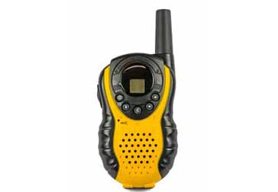
How FM was introduced
In the early days of radio, static was a major issue and the way everyone tried to reduce the effects of static was to reduce the bandwidth - in this way less noise was picked up by the receiver.
An American engineer named Edwin Armstrong was investigating this issue and whether frequency modulation, rather than amplitude modulation might provide an advantage.
Around 1928, Armstrong started to develop the concept of using FM, and rather than reducing the bandwidth, he increased it.

Slide 4
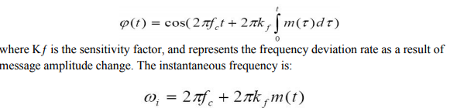
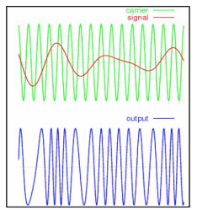
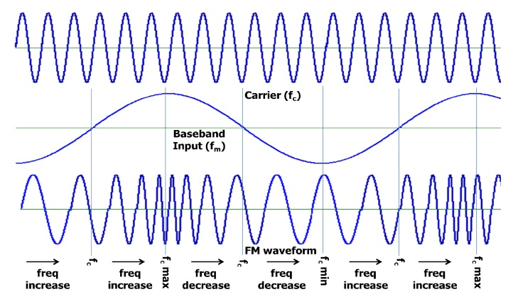
The FM-modulated signal has its instantaneous frequency that varies linearly with the amplitude of the message signal. Now we can get the FM-modulation by the following:

Slide 5
Frequency Deviation
The amount of change in the carrier frequency produced, by the amplitude of the input modulating signal, is called frequency deviation.
The Carrier frequency swings between fmax and fmin as the input varies in its amplitude.
The difference between fmax and fc is known as frequency deviation. fd = fmax – fc
Similarly, the difference between fc and fmin also is known as frequency deviation. fd = fc –fmin
It is denoted by Δf. Therefore Δf = fmax – fc = fc – fmin
Therefore fd = fmax – fc = fc – fmin

Slide 6
Modulating signal Amplitude | Frequency of Carrier | Deviation
0V | 100 MHz | Nil (Center frequency)
+2 V | 105 MHz | + 5 MHz
─ 2 V | 95 MHz | – 5 MHz

Slide 7
Frequency Modulation Equation
The FM equation include the following
v = A sin [ wct + (Δf / fm) sin wmt ]
m = Modulation Index of FM
m = ∆f/fm
m is called the modulation index of frequency modulation.
Modulation index is the ratio of maximum change in the frequency of the carrier signal to the frequency of the carrier signal.

Slide 8
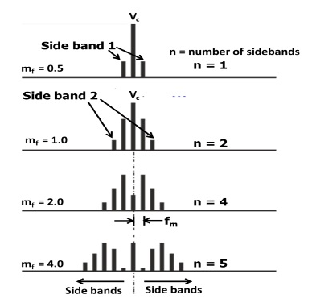
Bandwidth
FM signal spectrum is quite complex and will have an infinite number of sidebands as shown in the figure.
This figure gives an idea, how the spectrum expands as the modulation index increases. Sidebands are separated from the carrier by fc ± fm, fc ± 2fm, fc ± 3fm and so on.
Bandwidth of FM BWFM = 2 [ Δf + fm ].

Slide 9
Difference between AM and FM
In FM, carrier amplitude is constant, therefore transmitted power is constant.
Transmitted power does not depend on the modulation index
The number of significant sidebands in FM is large.
FM has better noise immunity.FM is rugged/robust against noise. The quality of FM will be good even in the presence of noise.
Circuits for FM transmitter and receiver are very complex and very expensive

Slide 10
Advantages of frequency modulation
FM is its resilience to noise and interference. It is for this reason that FM is used for high quality broadcast transmissions.
FM ideal for mobile radio communication applications including more general two-way radio communication or portable applications where signal levels are likely to vary considerably.

Slide 11
Applications
The applications of frequency modulation include in FM radio broadcasting, radar, telemetry, & observing infants for seizure through EEG, music synthesis, two-way radio systems, magnetic tape recording systems, video broadcast systems, etc.

Slide 12
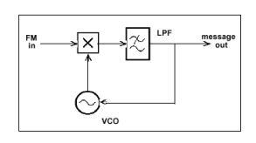
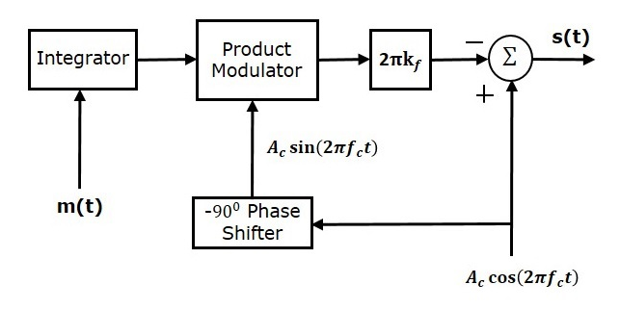
Block diagram of FM modulator and Demodulator

Slide 13

Experiment in Labalive

Slide 14

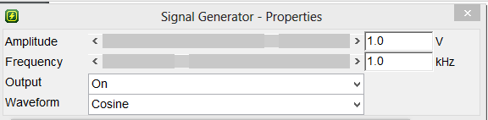
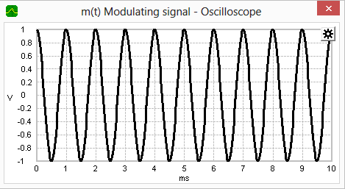

Slide 15

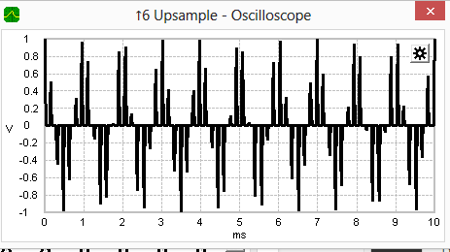

Slide 16

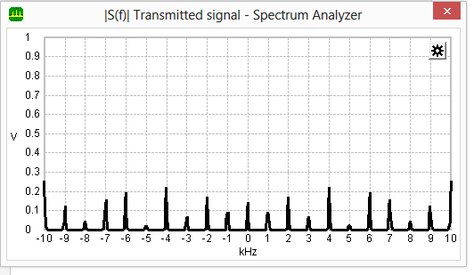

Slide 17

m(t) Demodulated signal - Oscilloscope

Slide 18

Experiment in Simulink

Slide 19
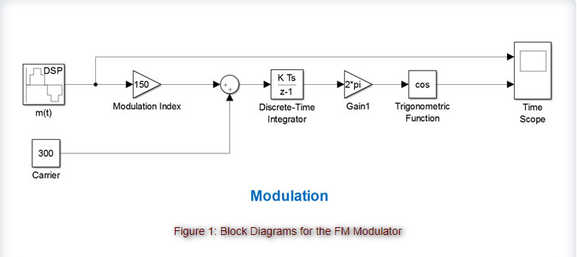
Simulink

Slide 20
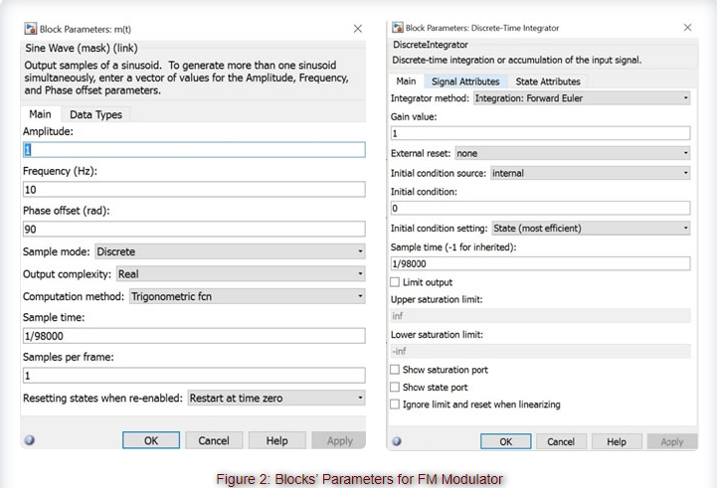

Slide 21
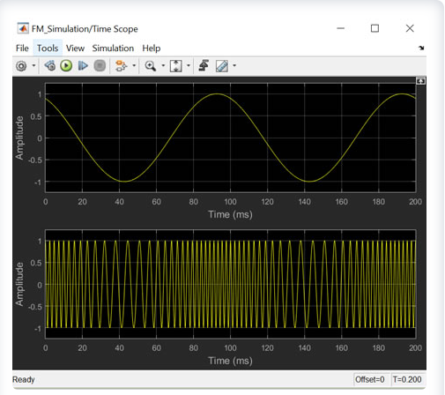

Slide 22
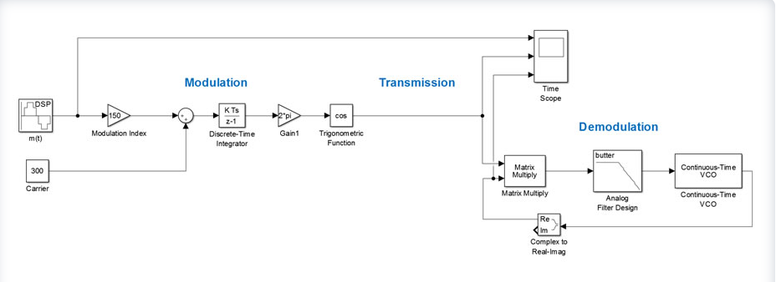

Slide 23
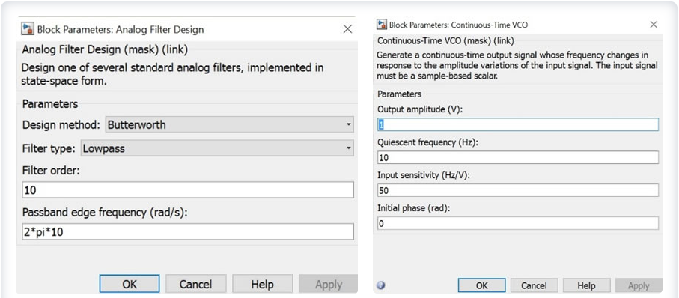

Slide 24
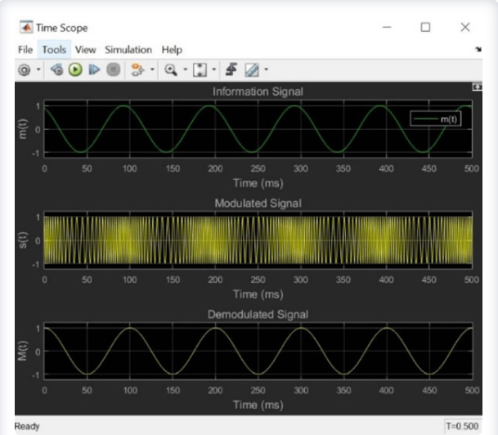

Slide 25

Experiment in MatLab

Slide 26
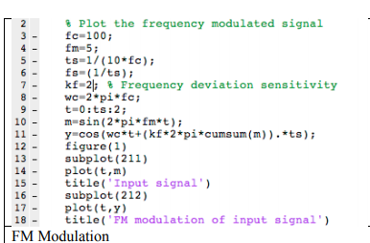
MatLab Code

Slide 27
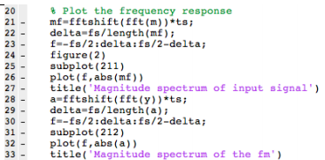

Slide 28
